Slide 1
Orange Services IT Bootcamp
AI Workshop
Intro in Artificial Intelligence & ML
Andrei Gabriel Popescu ~ Data Scientist
Bogdan Marian Cazan ~ Data Engineer

Slide 2
Content
Short recap
--- Bogdan
Intro to NN with Pytorch
--- Andrei
Intro to GANs / Generative models
--- Assignment questions ---

Slide 3
AI Course structure
Clustering
Classification
Regression
Intro to NN (neural networks) w/ PyTorch
- The optional assignment is on!!
Generative models
Anomaly detection - use case
- The optional assignment presentation!
For questions you can contact me:
- Andrei.popescu@orange.com

Slide 4
Intro to Pytorch
Intro to PyTorch
https://pytorch.org/tutorials/beginner/introyt/introyt1_tutorial.html
Intro to NNs using Pytorch
https://pytorch.org/tutorials/beginner/blitz/neural_networks_tutorial.html
MNIST with Pytorch
https://pythonguides.com/pytorch-mnist/

Slide 5
Generative models
Informally:
- Generative models can generate new data instances.
- Discriminative models discriminate between different kinds of data instances.
A generative model could generate new photos of animals that look like real animals, while a discriminative model could tell a dog from a cat. GANs are just one kind of generative model.
A generative model includes the distribution of the data itself, and tells you how likely a given example is. For example, models that predict the next word in a sequence are typically generative models (usually much simpler than GANs) because they can assign a probability to a sequence of words.
i.e VAE, GAN, Diffusion models

Slide 6
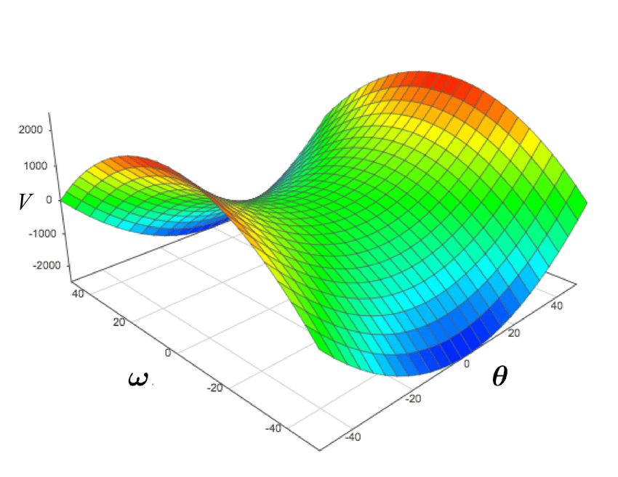
GANs
GANs are a class of generative models used to model complex distributions in an adversarial setting.
- Two entities, a Generator and a Discriminator, are competing in order to achieve an equilibrium point (Nash Equilibrium) in a sum-zero game.
Generative Adversarial Networks

Slide 7
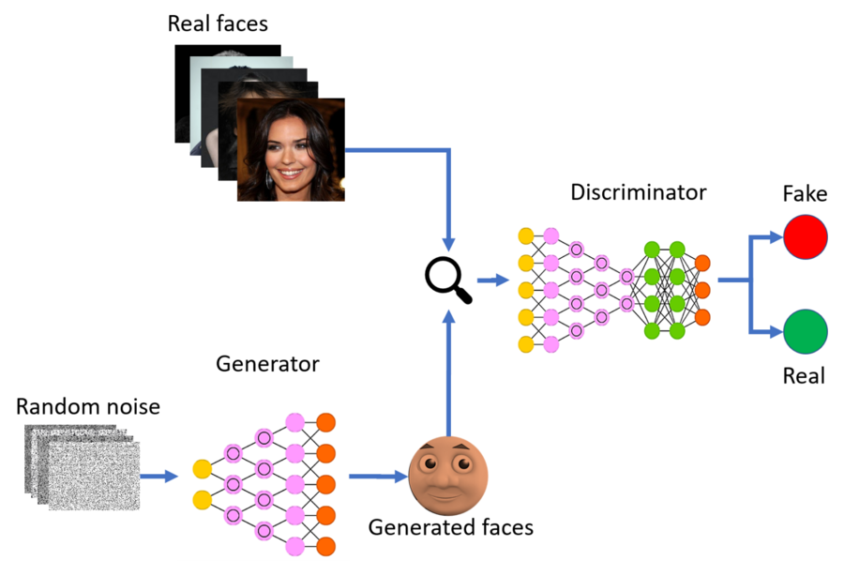
GANs
- The generator samples from a random noise distribution and tries to mimic the input data using the feedback from the Discriminator.
Generative Adversarial Networks

Slide 8
GANs
- The GAN can be defined as a minimax game where G wants to minimize V and at the same time D wants to maximize it
V is the total loss function
Generative Adversarial Networks

Slide 9
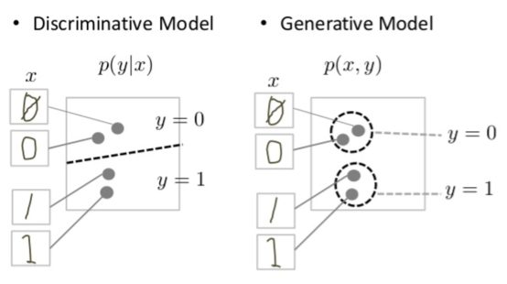
GANs
Generative Adversarial Networks

Slide 10
References
https://developers.google.com/machine-learning/gan/generative
https://arxiv.org/abs/1406.2661

Slide 11
Thanks

